Slide 1
Digit Recognizer
Patrick Steeves
Jingning Li
Yunning Zhu

Slide 2
Introduction
Correctly identify handwritten digits from the MNIST dataset. Known as the “hello world” of machine learning
Metrics to compare ourselves to:
0.8% error in original MNIST paper using support vector machine
0.21% error is the record

Slide 3
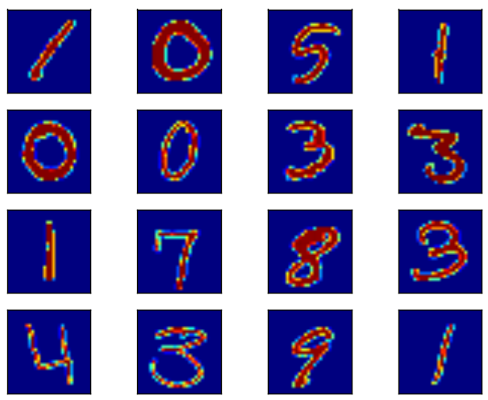
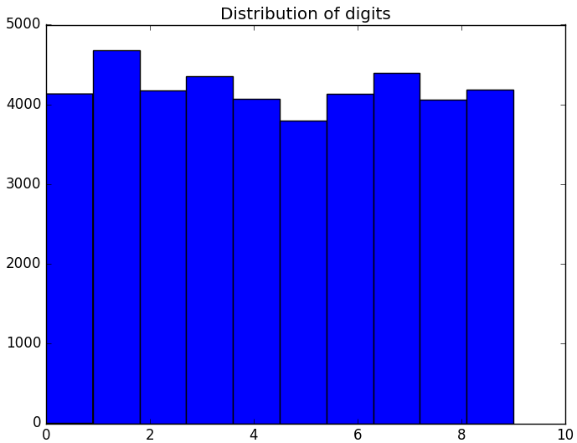
Data: MNIST dataset
Images of 28 x 28 pixels
Pixel values between 0 and 255
Training set of 42,000 records
and test set of 28,000 records

Slide 4
Data processing
Normalization of pixel values
Attempted PCA analysis but was not helpful
Attempted to augment training data through shifting, zooming, etc.

Slide 5
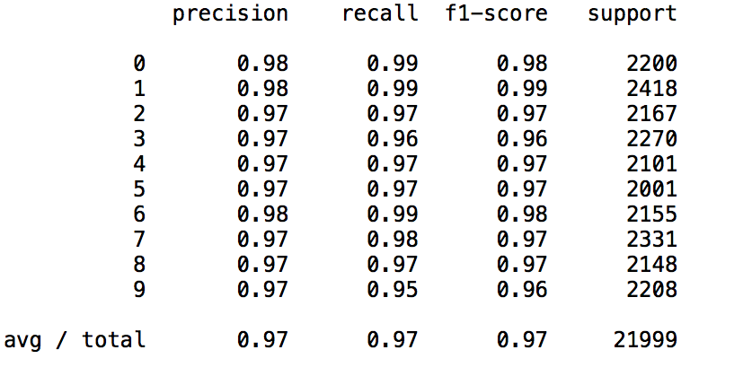
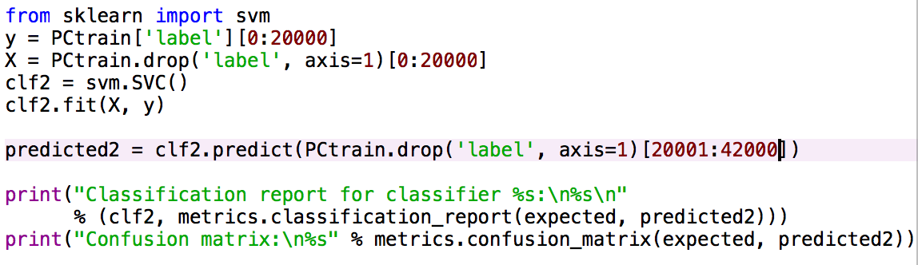
First attempt: SVM
Support Vector Machine
Package: Sklearn
Accuracy: 0.97

Slide 6
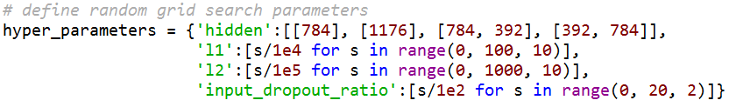
Second attempt: Feed forward neural net
Used h2o random grid search and hyper parameter tuning
Best performing model:
1 layer, 1176 hidden inputs
0.14 input dropout ratio
0.0 l1 penalty, 0.002 l2 penalty
0.965 accuracy

Slide 7
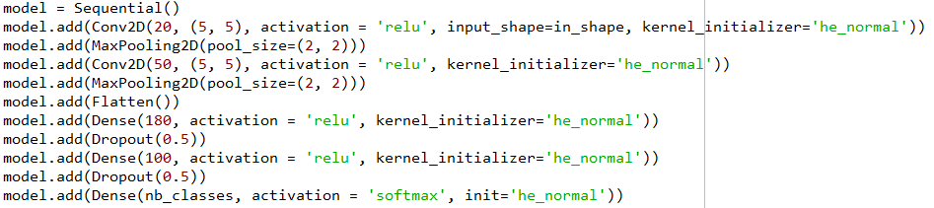
Best model: Convolutional neural net
Early Stopping to prevent overfitting
Save only best model with respect to prediction accuracy

Slide 8
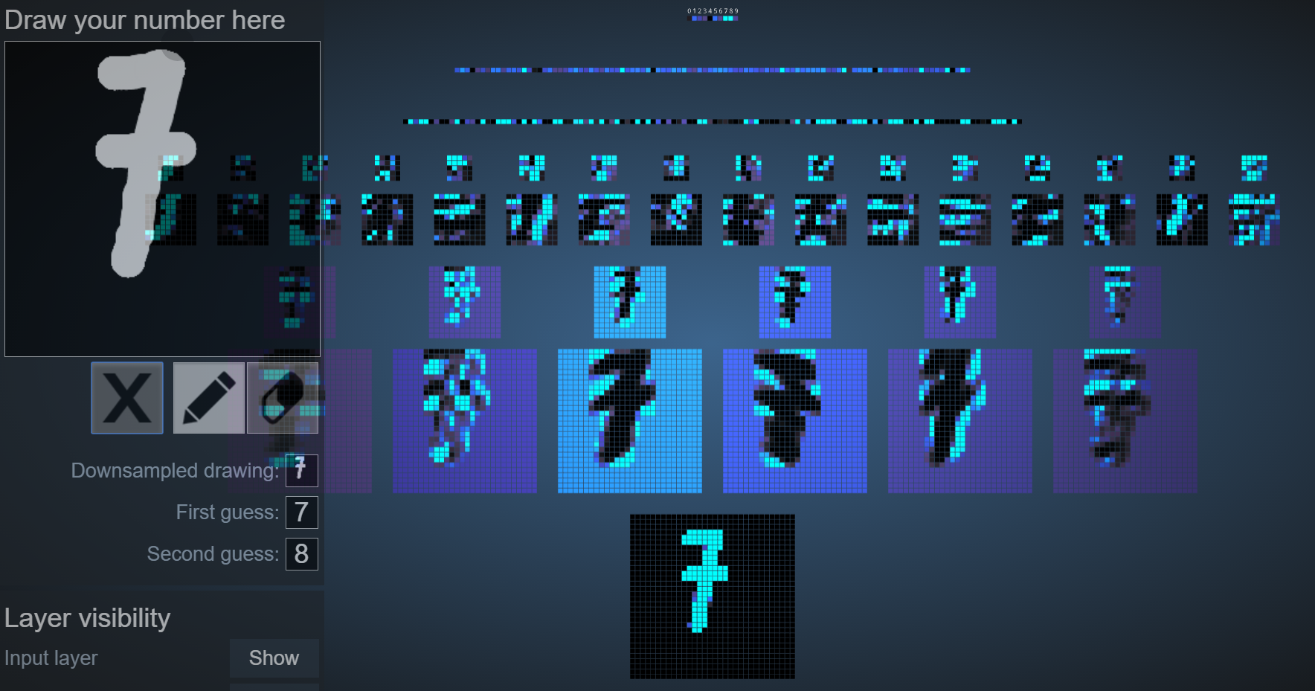
Model visualization
http://scs.ryerson.ca/~aharley/vis/conv/flat.html

Slide 9
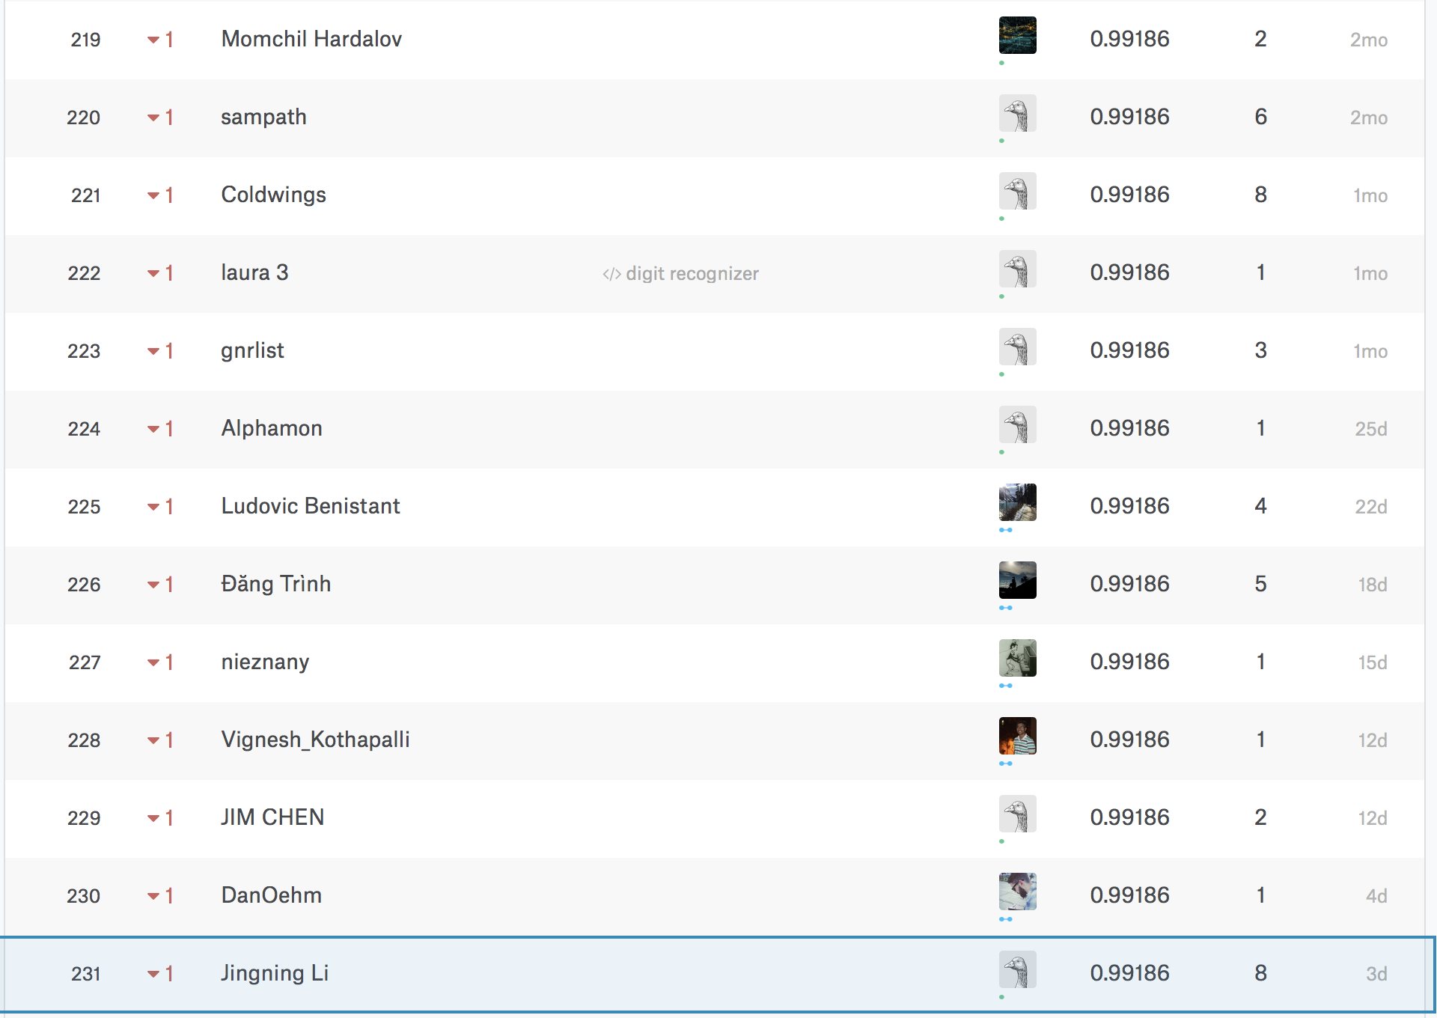
Results
0.81% error rate on test set
Tied for 219 of 1,592

Slide 10
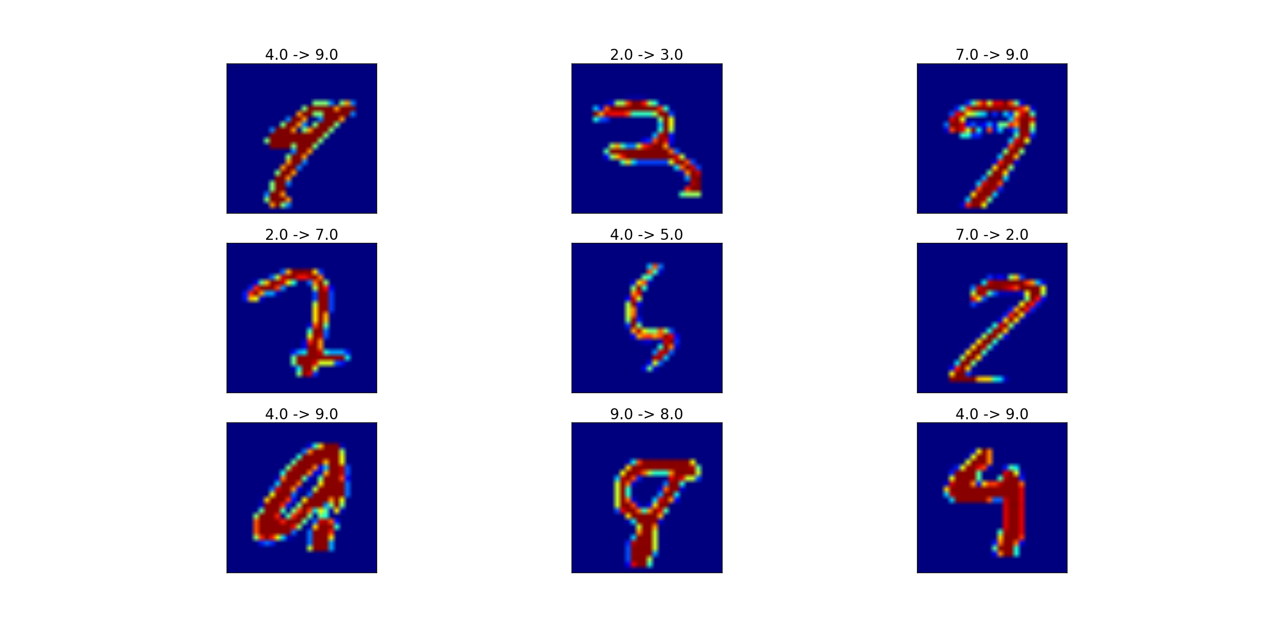
Results
Misclassification examples

Slide 11
Thank you

